Slide 1
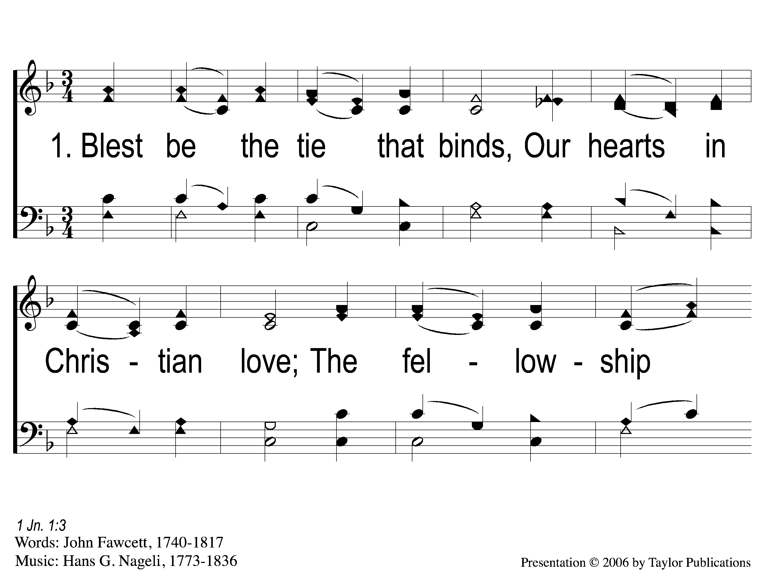
1-1 Blest Be the Tie That Binds
Blest Be the Tie That Binds
46

Slide 2
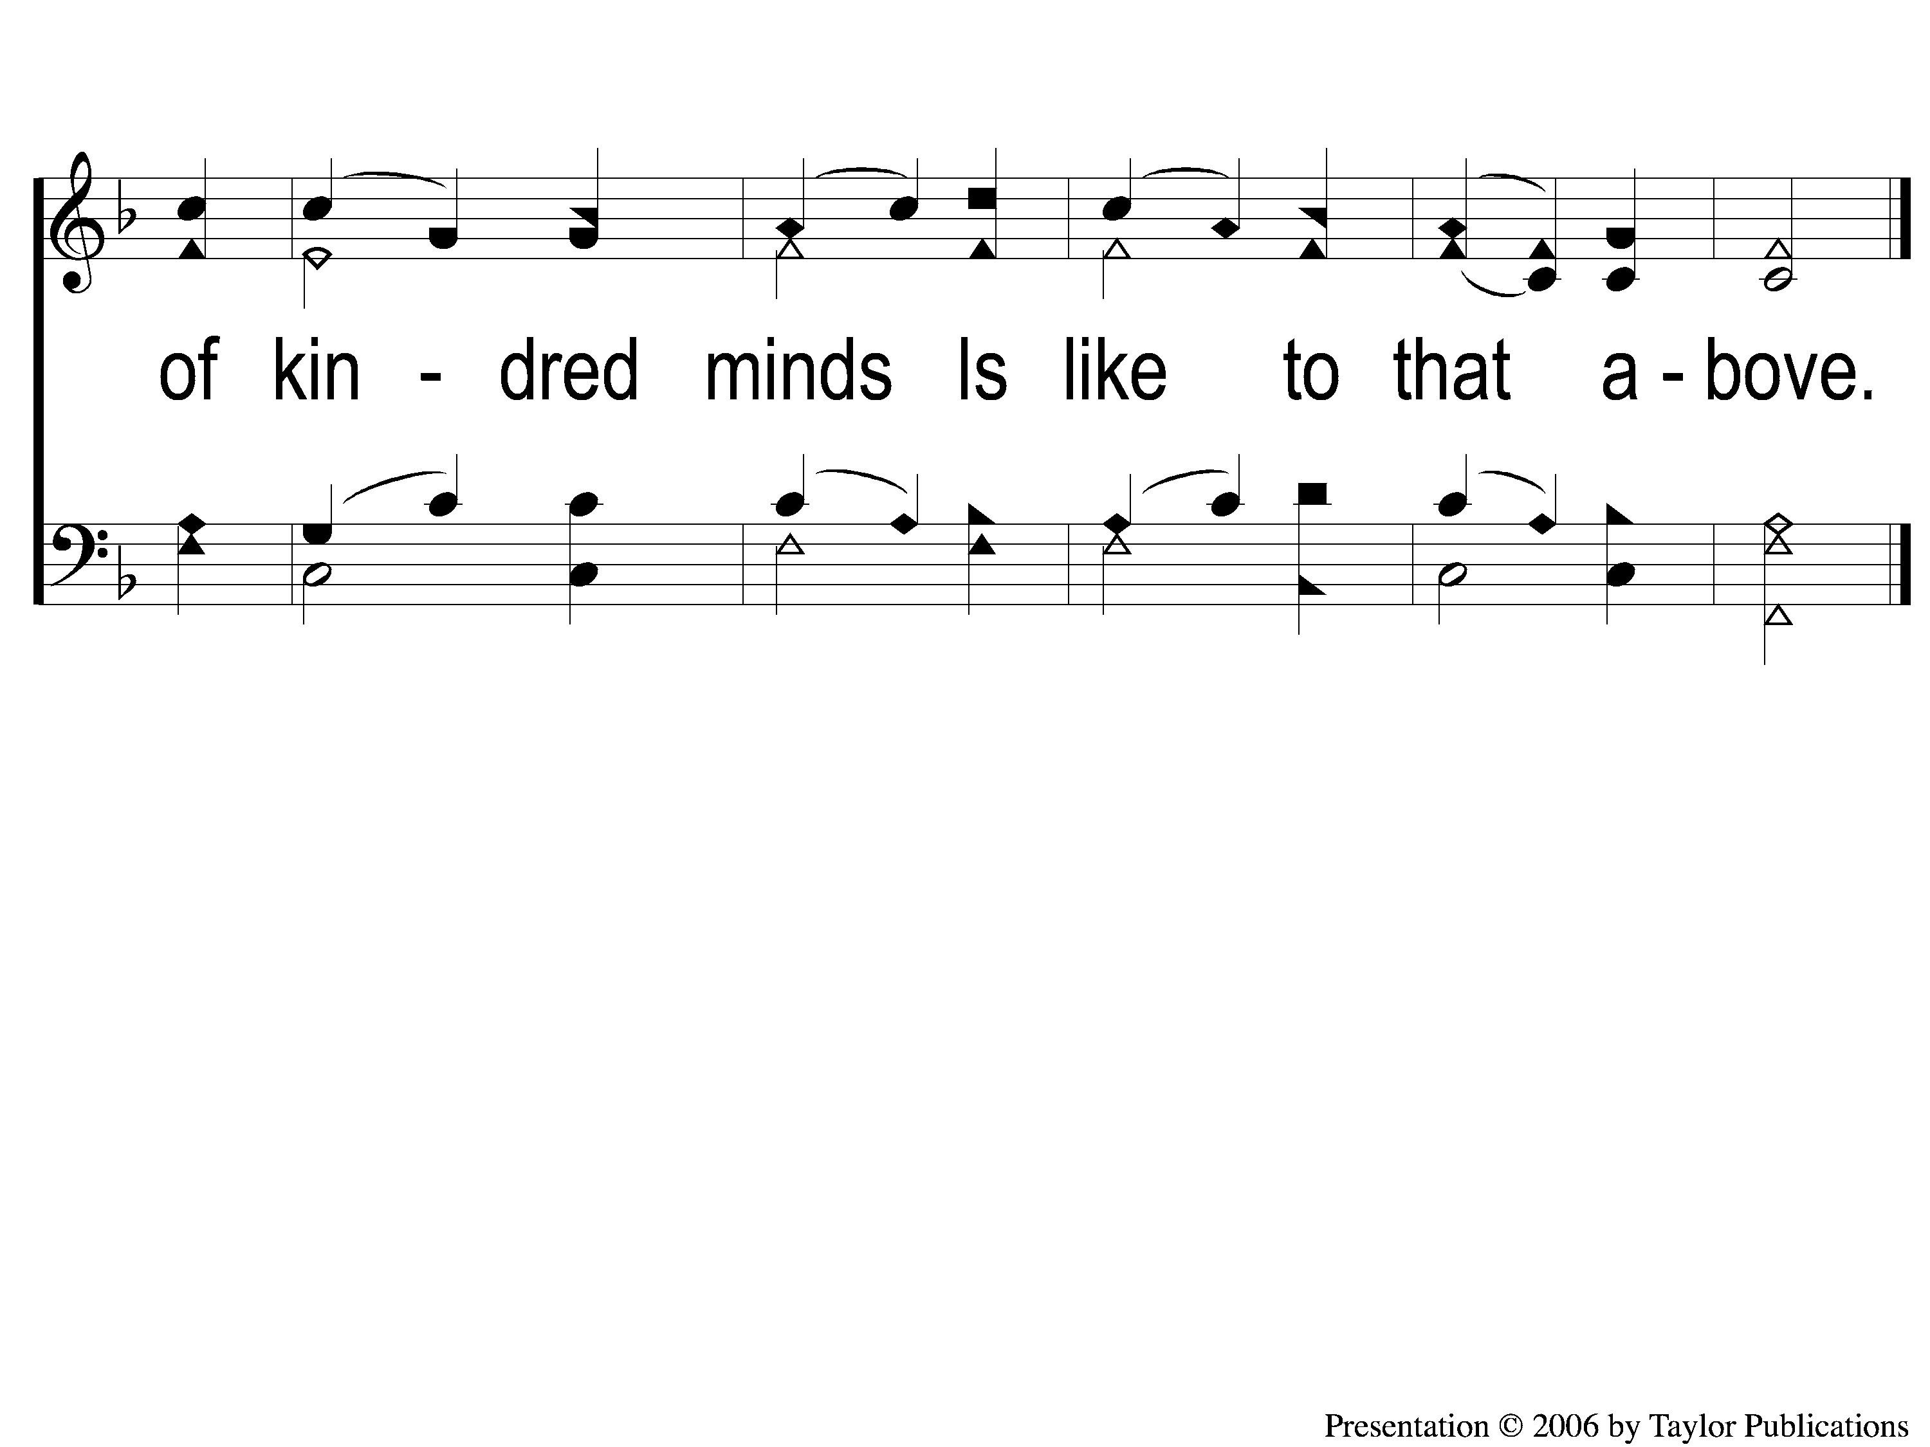
1-2 Blest Be the Tie That Binds
Blest Be the Tie That Binds
46

Slide 3
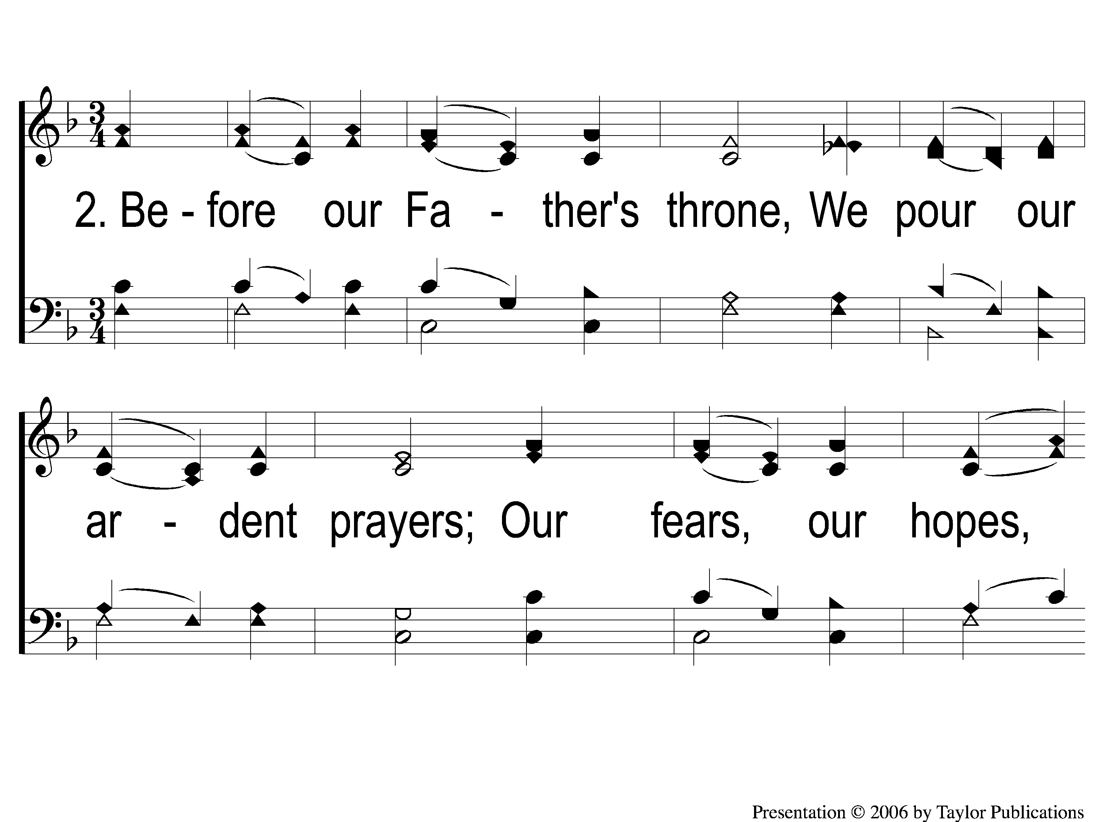
2-1 Blest Be the Tie That Binds
Blest Be the Tie That Binds
46

Slide 4
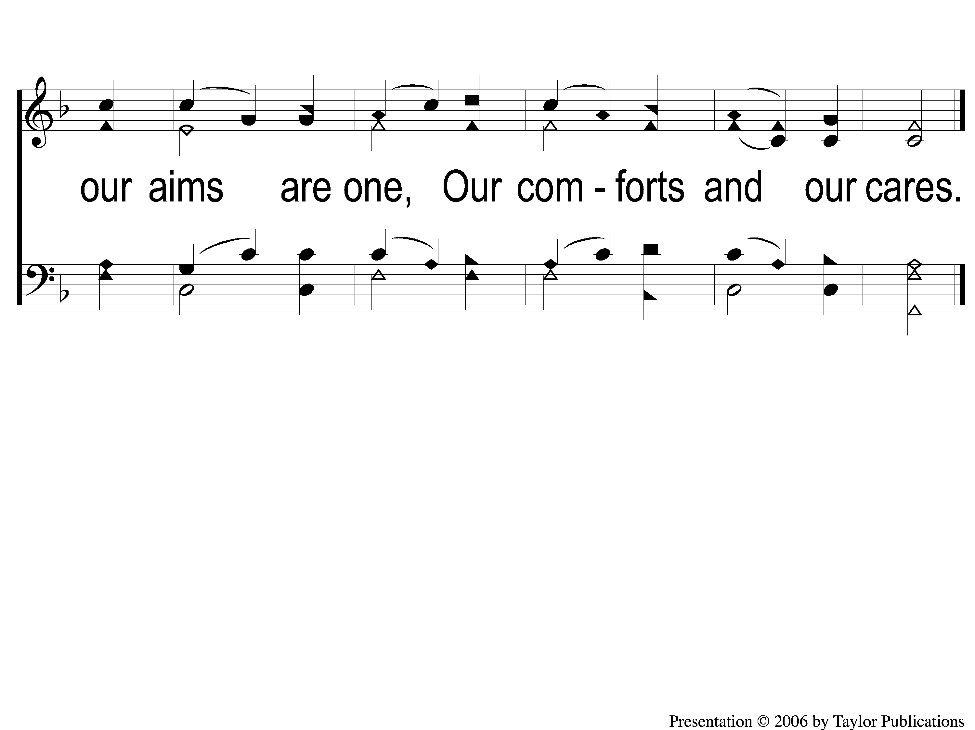
2-2 Blest Be the Tie That Binds
Blest Be the Tie That Binds
46

Slide 5
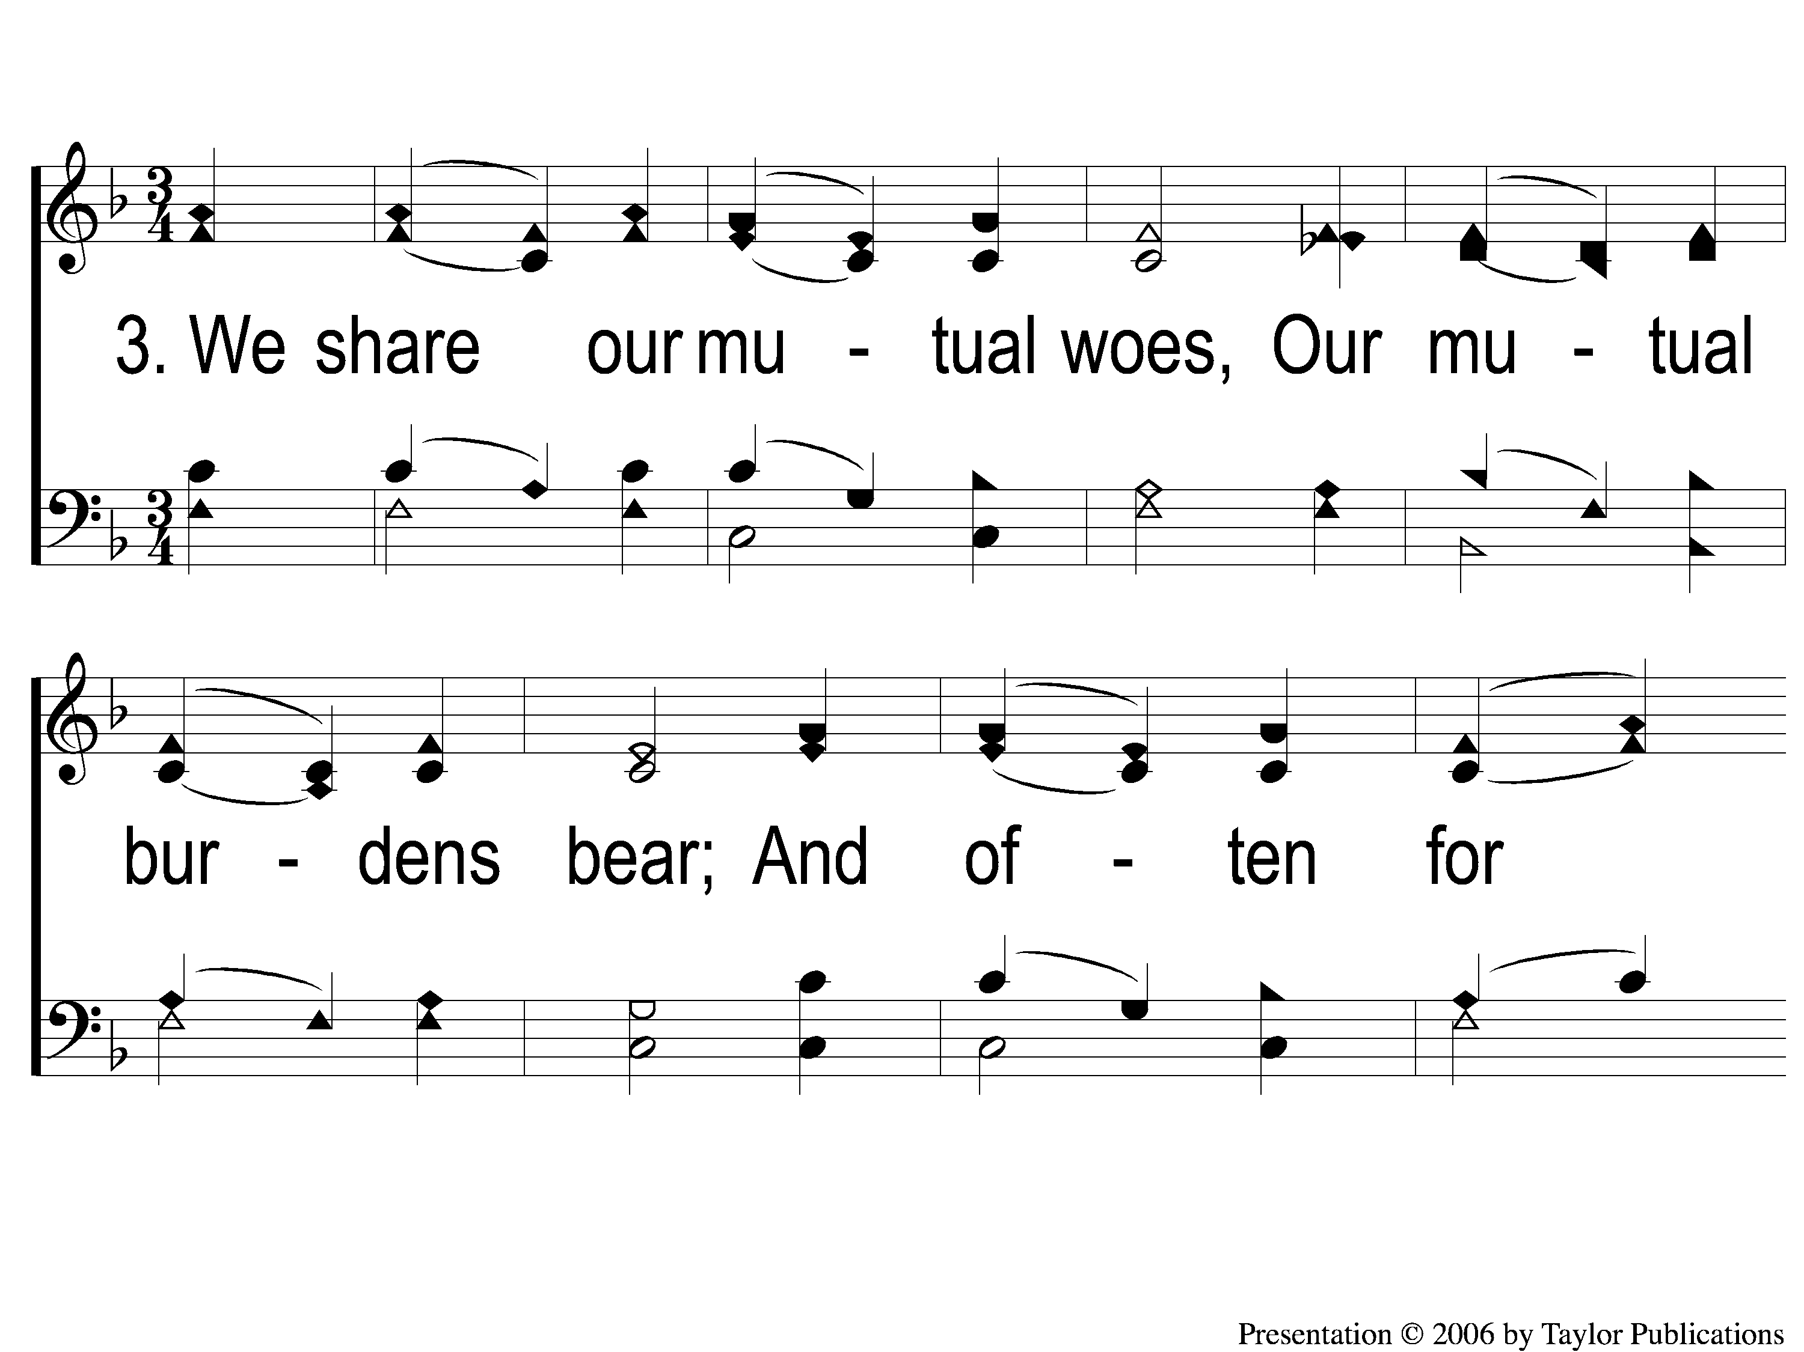
3-1 Blest Be the Tie That Binds
Blest Be the Tie That Binds
46

Slide 6
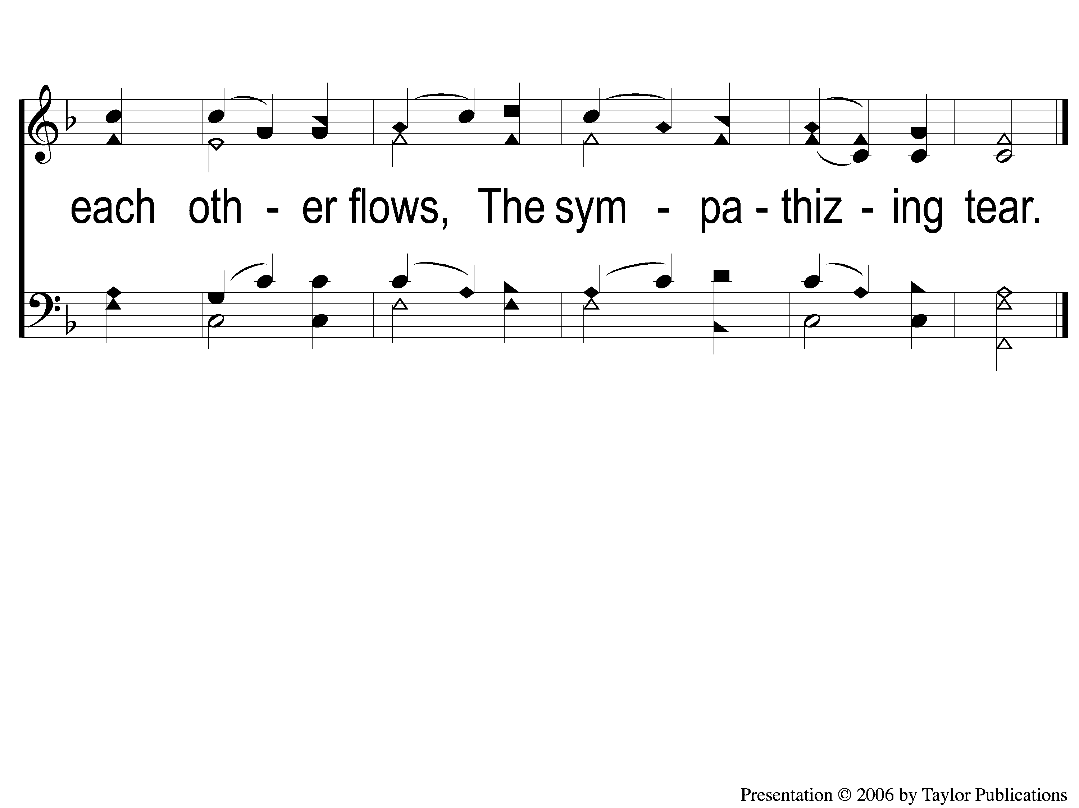
3-2 Blest Be the Tie That Binds
Blest Be the Tie That Binds
46

Slide 7
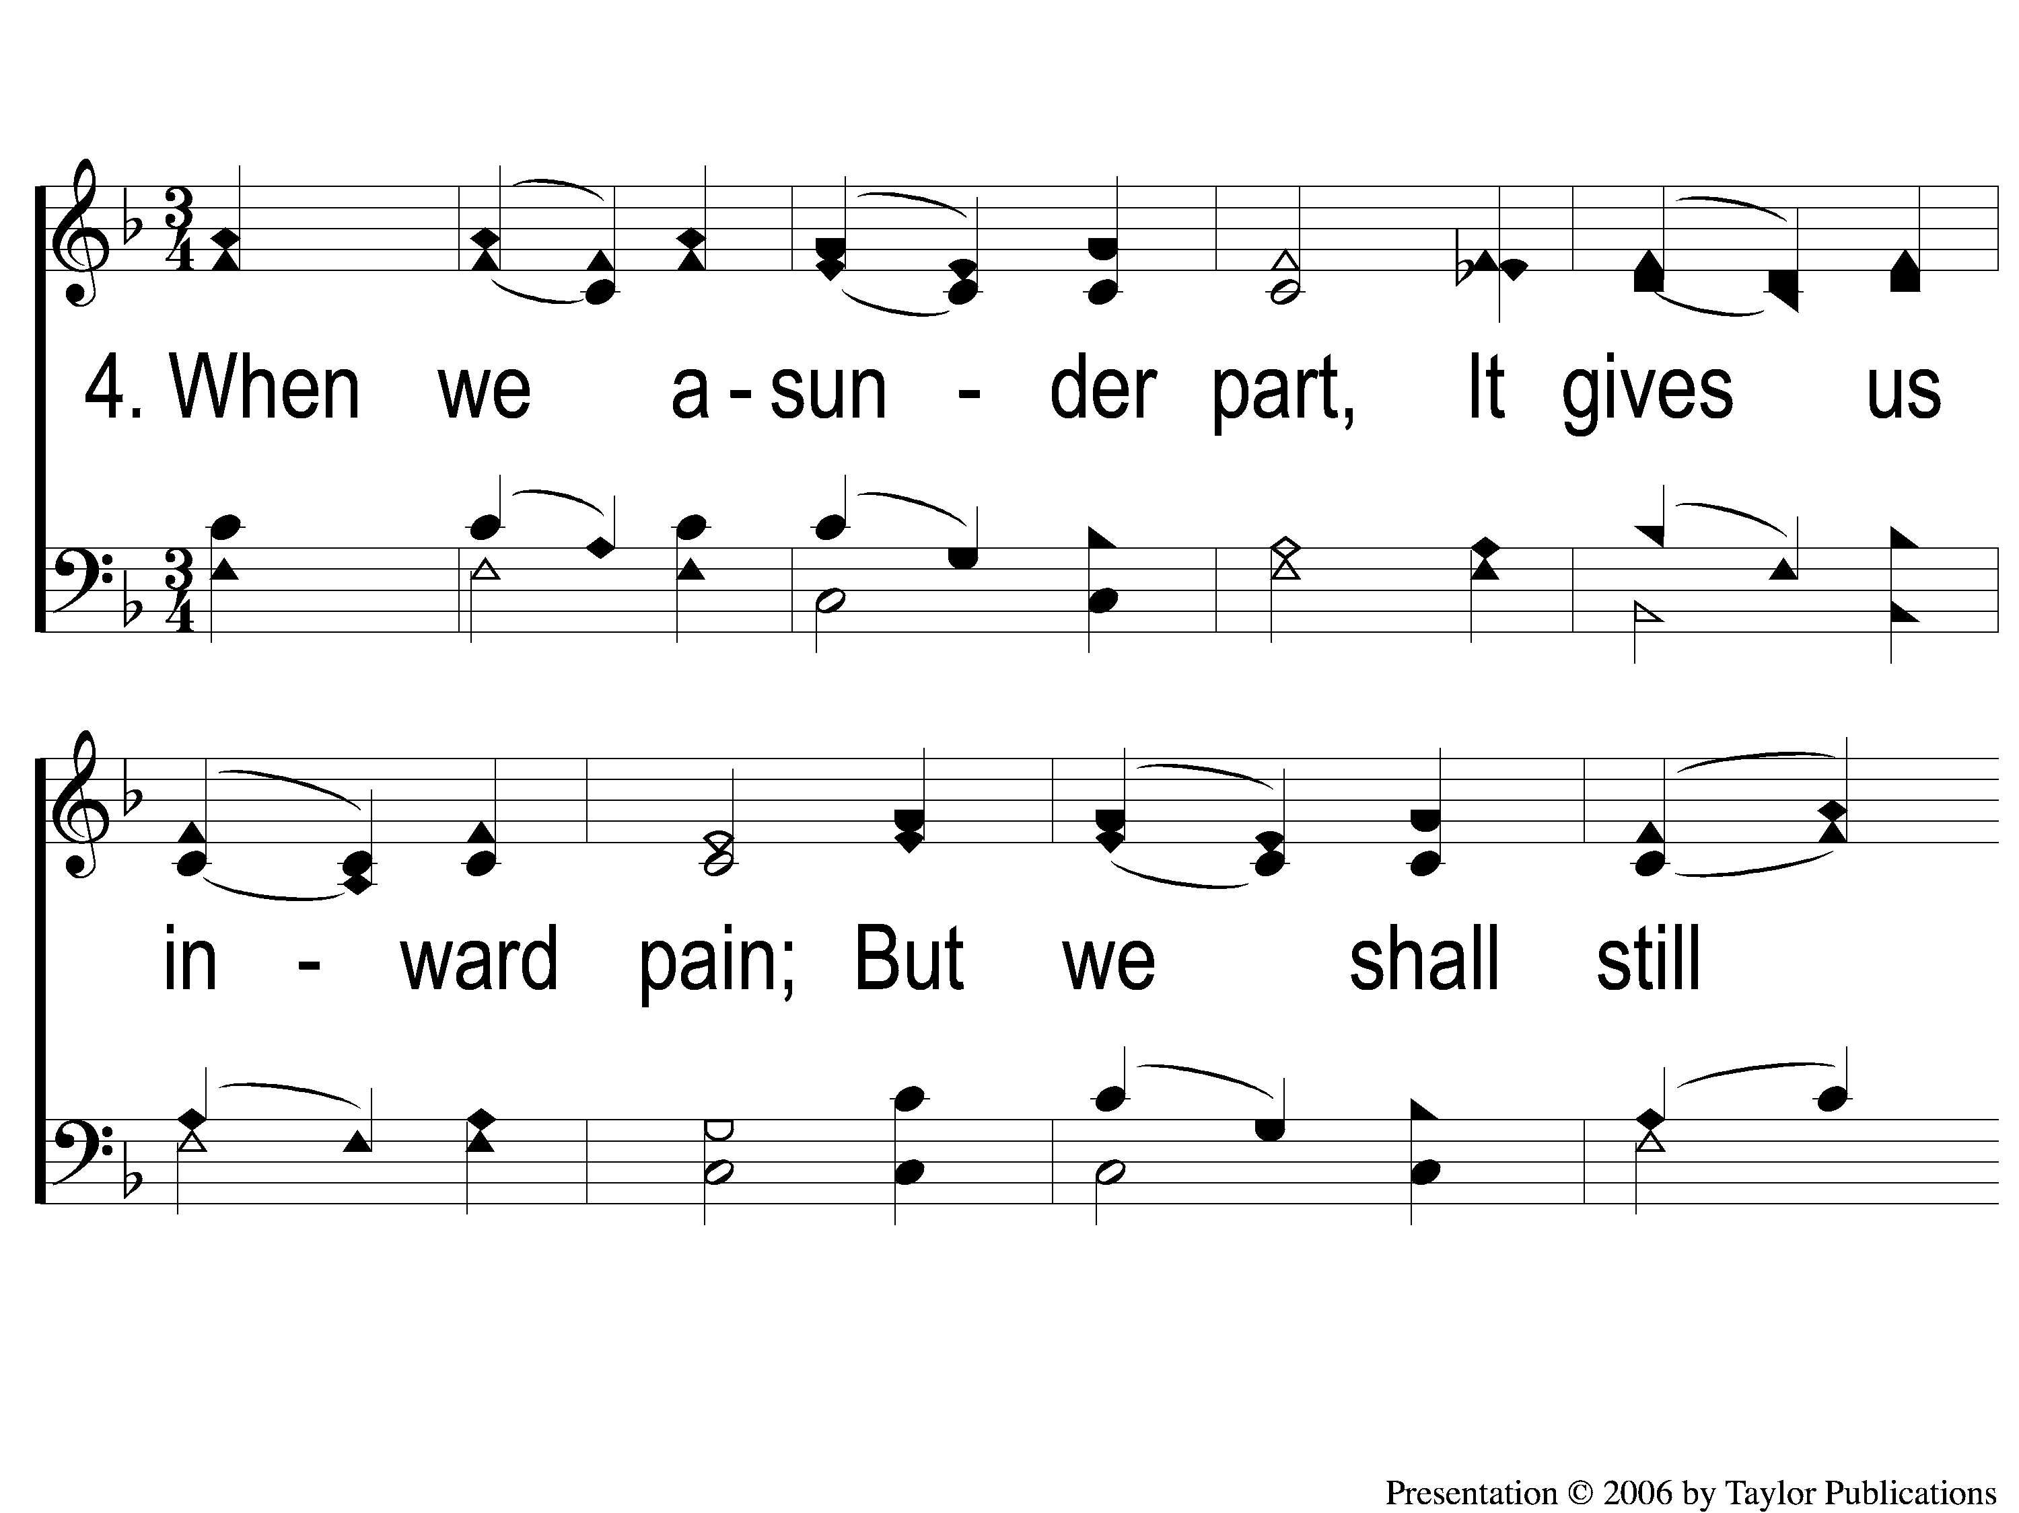
4-1 Blest Be the Tie That Binds
Blest Be the Tie That Binds
46

Slide 8
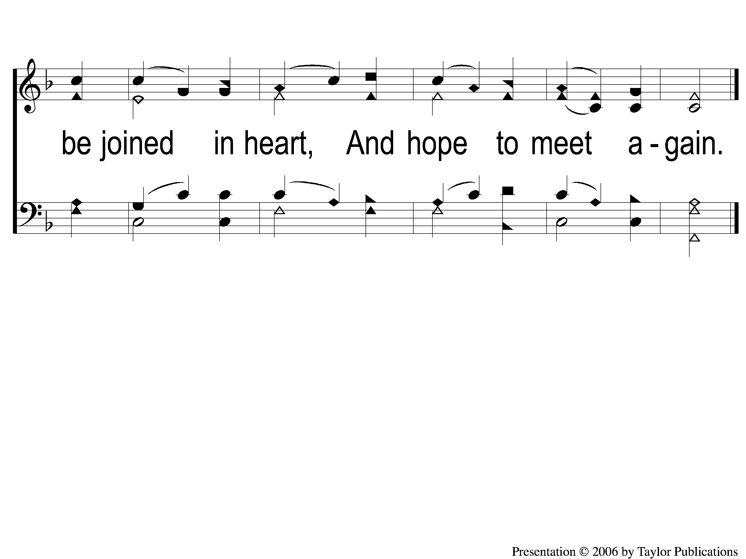
4-2 Blest Be the Tie That Binds
Blest Be the Tie That Binds
46

